Slide 1
Afrizal Doewes
Arif Rohmadi
SQL

Slide 2
What is SQL?
SQL stands for Structured Query Language
SQL lets you access and manipulate databases
SQL became a standard of the American National Standards Institute (ANSI) in 1986, and of the International Organization for Standardization (ISO) in 1987

Slide 3
What Can SQL do?
SQL can execute queries against a database
SQL can retrieve data from a database
SQL can insert records in a database
SQL can update records in a database
SQL can delete records from a database
SQL can create new databases
SQL can create new tables in a database
SQL can create stored procedures in a database
SQL can create views in a database
SQL can set permissions on tables, procedures, and views

Slide 4
SQL Commands
DDL - Data Definition Language
DML - Data Manipulation Language
DCL - Data Control Language
DQL - Data Query Language

Slide 5
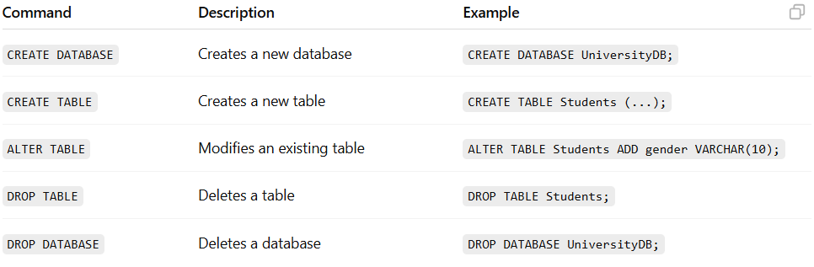
DDL
DDL (Data Definition Language) is a category of SQL commands used to define and manage all structures in a database, such as databases, tables, and indexes. These commands allow users to create, modify, and delete database objects.

Slide 6
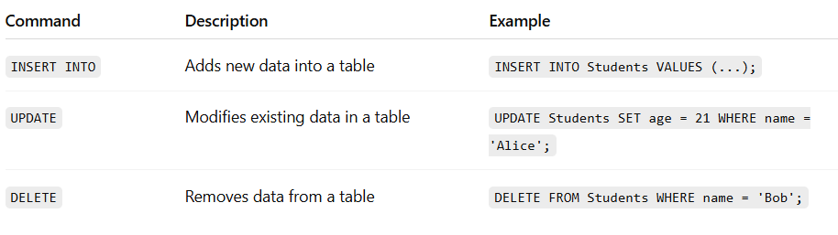
DML
DML (Data Manipulation Language) refers to SQL commands that are used to manage and manipulate the data stored within database tables. Unlike DDL, which changes the structure of the database, DML works with the actual data. These commands allow users to insert new records, update existing records, and delete unwanted records.

Slide 7
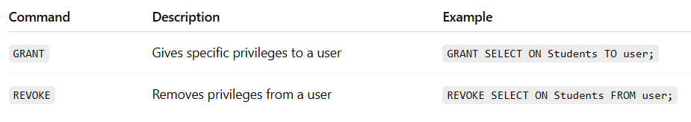
DCL
DCL (Data Control Language) includes SQL commands that control access to data in the database. These commands are used to grant or revoke permissions and privileges to users or roles, ensuring that only authorized users can perform certain operations on database objects.

Slide 8

DQL
DQL (Data Query Language) consists of SQL commands used to query and retrieve data from databases. The primary purpose of DQL is to fetch data based on specific conditions using the SELECT statement. Unlike DML, DQL does not modify data—it only reads and returns the requested information.

Slide 9
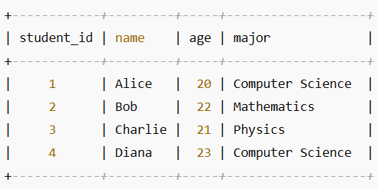
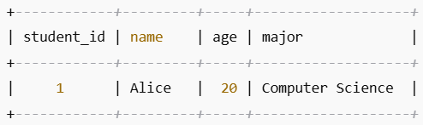
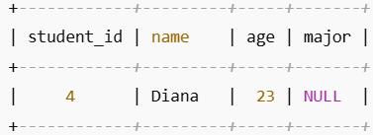
SQL RDBMS Concepts
Table
  Record
  Column
  Cell
  NULL ?

Slide 10
SQL RDBMS Concepts
SQL Constraints: (applied on columns)
  NOT NULL Constraint
  UNIQUE Constraint
  PRIMARY Key
  FOREIGN Key
  CHECK Constraint
  Data Integrity:
    Entity Integrity: There are no duplicate rows in a table
    Domain Integrity: Enforces valid entries for a given column by restricting the type
    Referential Integrity: Rows cannot be deleted which are used by other records
    User-Defined Integrity: Enforces some specific business rules

Slide 11
SQL RDBMS Concepts
Data Types
Character datatypes:
  CHAR
  VARCHAR
  Numeric datatypes:
    INT
    FLOAT
    DOUBLE
  Date time dataytpes:
    DATE
    DATETIME

Slide 12
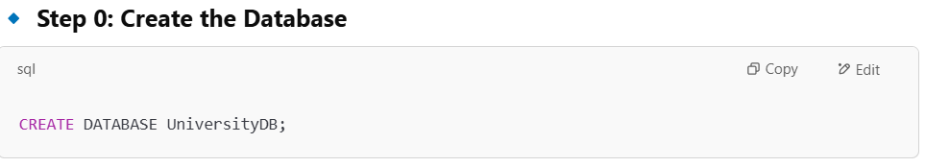
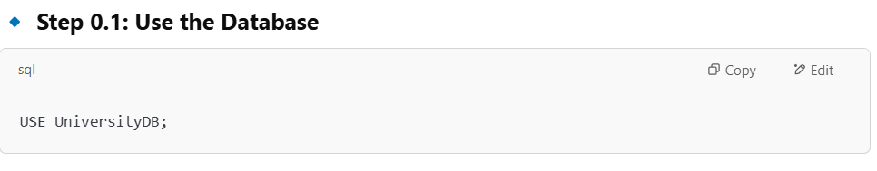
Exercises

Slide 13
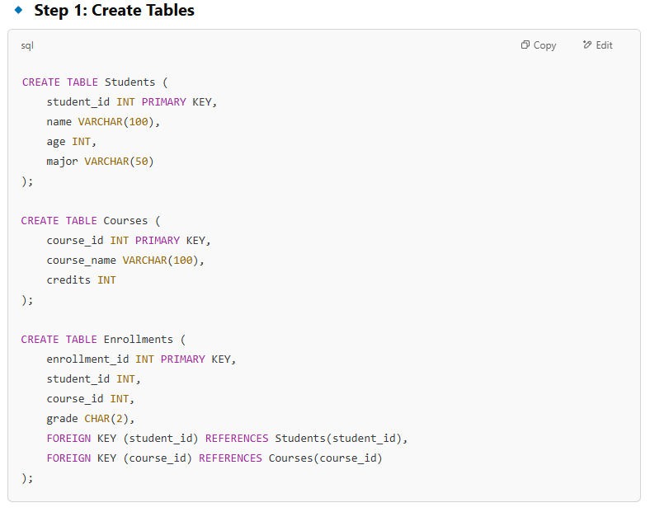

Slide 14
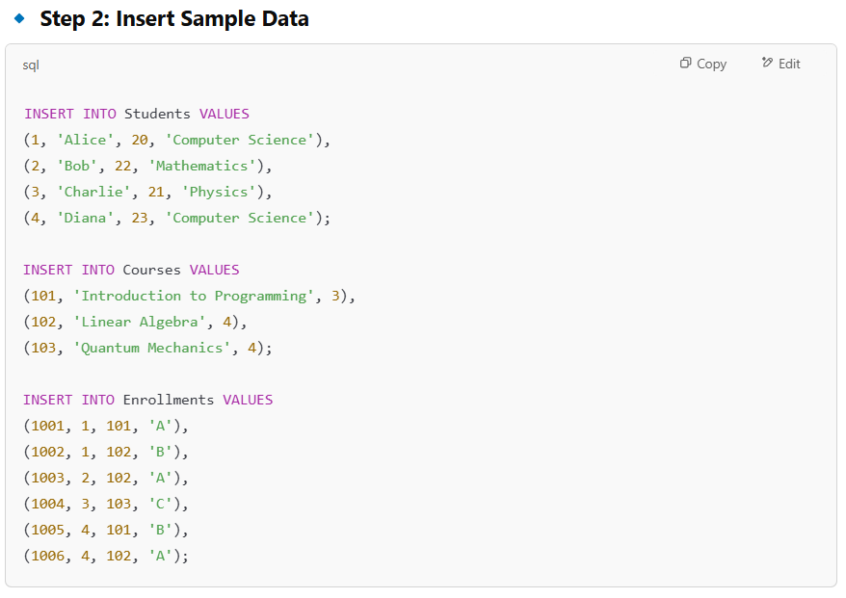

Slide 15
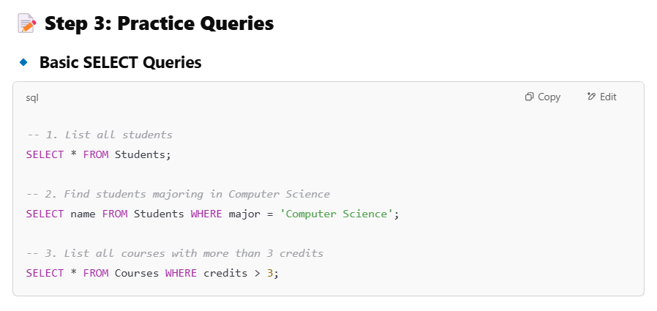
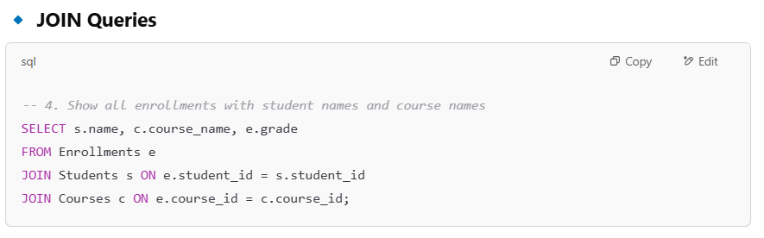

Slide 16
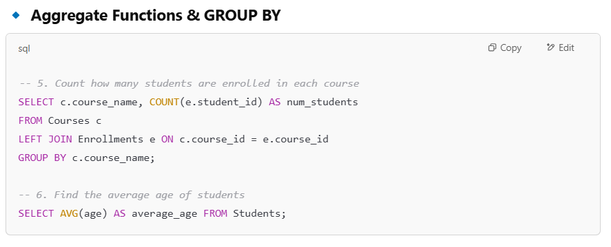
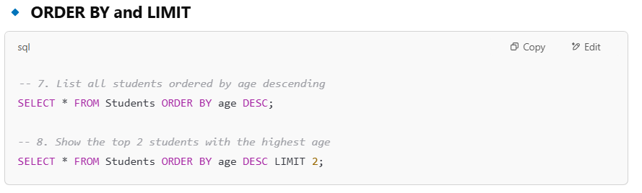

Slide 17
